Slide 1
CS 2212
Introduction to Software Engineering
Chapter 4 Recommended Process Model

Slide 2
Copyright Notice This Presentation and Its Associated Video Contain Copyright Material. This Presentation and Its Associated Video Are Provided for Teaching Purposes of CS2212 and Should Not Be Posted In Any External Site, Or Shared with. This Presentation and Its Associated Video Are Provided For Instructional Personal Use Only, and Only For The Purposes of the CS2212 Course.

Slide 3
Part 14
Recommended Process Model Road Map
Software is easy to make, except when you want it to do something new. And then, of course, there is a corollary: The only software that's worth making is software that does something new.
- Scott Rosenberg

Slide 4
Learning Objectives in this Part
To get an overview of the activities applied during the Software Life Cycle (SLC)
To see examples and get an overview of the PERT graphs and Gantt Charts

Slide 5
Action 1: Requirements Definition
Encourage active stakeholder participation by matching their availability and valuing their input.
Use simple models (e.g., Post-it notes, fast sketches, user stories) to reduce barriers to participation.
Take time to explain your requirement representation techniques before using them.
Adopt stakeholder terminology, and avoid technical jargon whenever possible.
Use a breadth-first approach to get the big picture of the project done before getting bogged down in details.
Allow the development team to refine (with stakeholder input) requirement details “just in time” as user stories are scheduled to be implemented.
Treat the list of features to be implemented like a prioritized list, and implement the most important user stories first.
Collaborate closely with your stakeholders and only document requirements at a level that is useful to all when creating the next prototype.
Question the need to maintain models and documents that will not be referred to in the future.
Make sure you have management support to ensure stakeholder and resource availability during requirements definition.

Slide 6
Action 2: Preliminary Architectural Design
Focus on key quality attributes, and incorporate them into prototypes as they are constructed.
When planning prototypes, keep in mind that successful software products combine customer-visible features and the infrastructure to enable them.
Recognize that an agile architecture enables code maintainability and evolvability if sufficient attention is paid to architectural decisions and related quality issues.
Continuous management and synchronization of dependencies between the functional and architectural requirements is needed to ensure the evolving architectural foundation will be ready just in time for future increments.

Slide 7
Action 3: Resource Estimation
Use historic data and work as a team to develop an estimate of how many days it will take to complete each of the user stories known at the start of the project.
Loosely organize the user stories into the sets that will make up each sprint planned to complete a prototype.
Sum the number of days to complete each sprint to provide an estimate for the duration of the total project.
Revise the estimate as requirements are added to the project or prototypes are delivered and accepted by the stakeholders.

Slide 8
Action 4: First Prototype Construction
Transition from paper prototype to software design
Prototype a user interface
Create a virtual prototype
Add input and output to your prototype
Engineer your algorithms
Test your prototype
Prototype with deployment in mind

Slide 9
Action 5: Prototype Evaluation
Provide scaffolding when asking for prototype feedback.
Test your prototype on the right people.
Ask the right questions.
Be neutral when presenting alternatives to users.
Adapt while testing.
Allow the user to contribute ideas.

Slide 10
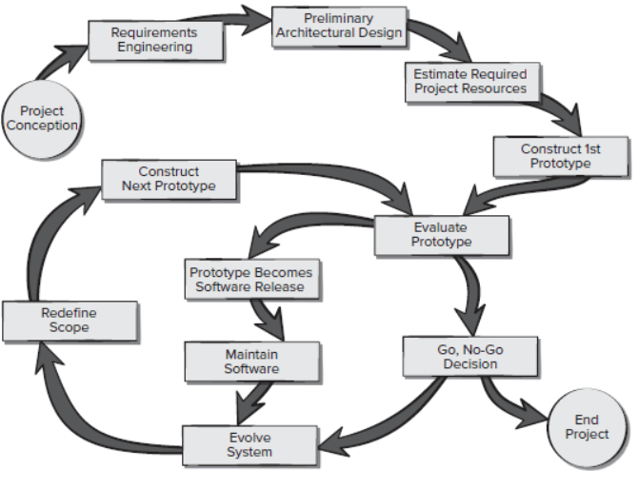
Action 6: Go-no-Go Decision Process

Slide 11
Action 7: Evolution of Prototypes
Once a prototype has been developed and reviewed by the development team and other stakeholders, it’s time to consider the development of the next prototype.
The first step is to collect all feedback and data from the evaluation of the current prototype. The developers and stakeholders then begin negotiations to plan the creation of another prototype.
Once the desired features for the new prototype have been agreed upon, consideration is given to any known time and budget constraints as well as the technical feasibility of implementing the prototype. If the development risks are deemed to be acceptable, the work continues.
Each prototype should be designed to allow for future changes to avoid throwing it away and creating the next prototype from scratch.

Slide 12
Planning the Project Activities
Two commonly used methods for planning and documenting a project are the Pert graphs and the Gantt charts. These methods are complementary to each other.
The PERT method is a statistical tool used in project management, which was designed to analyze and represent the tasks involved in completing a given project [1].
The Gantt method provides a bar chart that illustrates a project schedule depicting the dependency relationships between activities and current schedule status [2].
[1] https://en.wikipedia.org/wiki/Program_evaluation_and_review_technique
[2] https://en.wikipedia.org/wiki/Gantt_chart

Slide 13
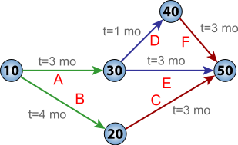
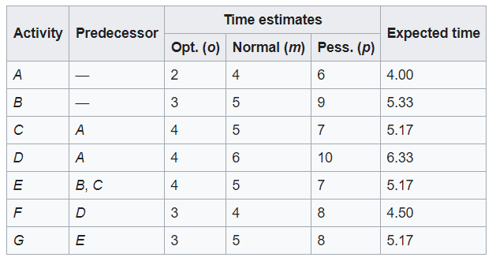


PERT Graphs
PERT is a method of analyzing the tasks involved in completing a given project.
It incorporates uncertainty by making it possible to schedule a project while not knowing precisely the details and durations of all the activities.
PERT has defined four types of time required to accomplish an activity:
optimistic time (o)
pessimistic time (p)
most likely time (m)
expected time (te)
PERT network chart for a seven-month project with five milestones (10 through 50) and six activities (A through F).
for an activity
for a path
Source Wikipedia: https://en.wikipedia.org/wiki/Program_evaluation_and_review_technique

Slide 14
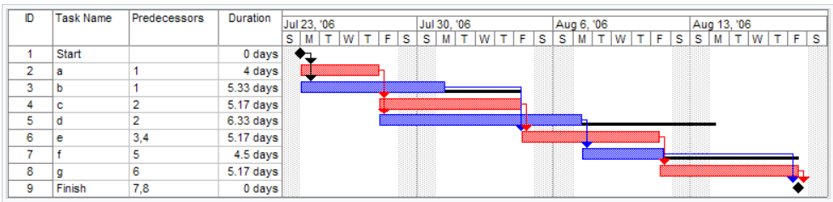
Gantt Charts
A Gantt chart is bar chart that illustrates a project schedule.
The width of the horizontal bars in the graph shows the duration of each activity.
Gantt charts illustrate the start and finish dates of the elements which constitute the work breakdown structure of the project.
Modern Gantt charts also show the dependency (i.e., precedence network) relationships between activities.
PERT network chart for a seven-month project with five milestones (10 through 50) and six activities (A through F).
Source Wikipedia: https://en.wikipedia.org/wiki/Gantt_chart

Slide 15
Your Turn
Why is it important for the development team to use stakeholders' jargon?
Discuss the basic activities during the Preliminary Architectural Design.
List four reasons for reaching a No-Go decision for a project.
List four parameters which you can use to evaluate a prototype.
Check-out the content of the following resource and sites:
https://www.projectsmart.co.uk/the-project-go-no-go-checklist.php
https://acuityppm.com/ppm-101-project-portfolio-decision-making-framework/
https://ntrs.nasa.gov/archive/nasa/casi.ntrs.nasa.gov/19870015473.pdf
https://www.seguetech.com/preliminary-design-improve-development/
https://www.altexsoft.com/blog/business/agile-software-development-metrics-and-kpis-that-help-optimize-product-delivery/

